Slide 1
Mobile Application Development
Lecture 4

Slide 2
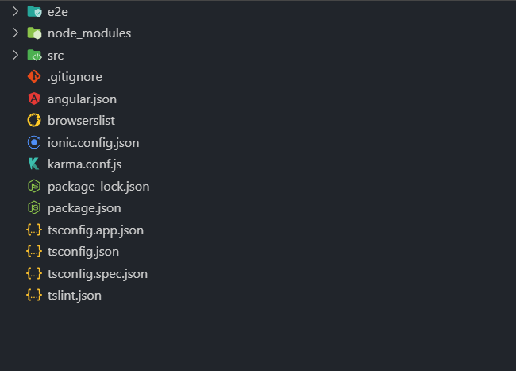
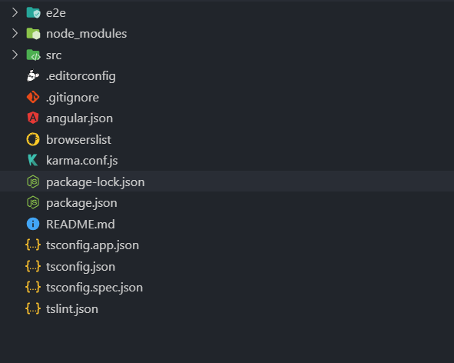
Angular and Ionic Folder Structure
Ionic Angular

Slide 3
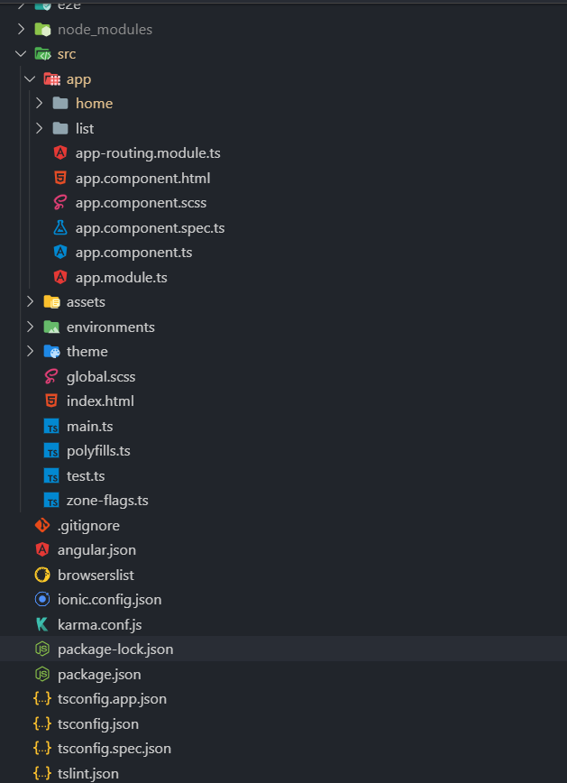
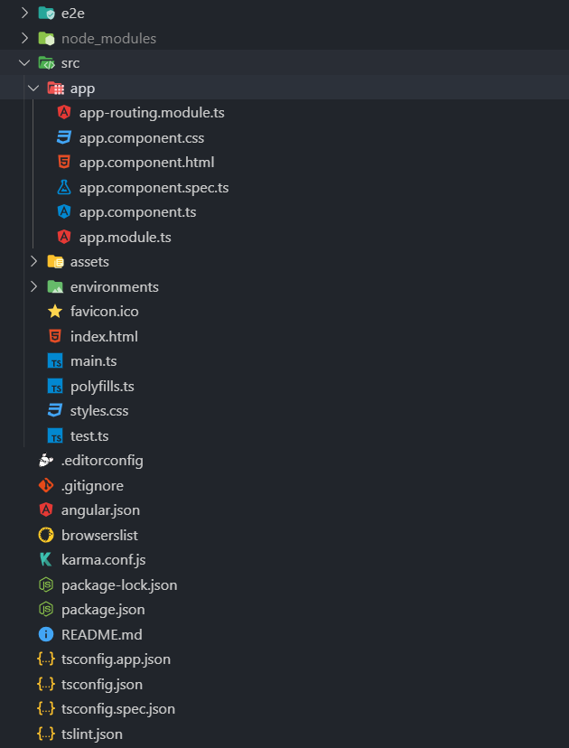
Ionic
Angular

Slide 4
Angular and Ionic Folder Structure
Point is, there isn’t really much of a difference.
Lets dive into each and every file/folder. We don’t need to understand how everything is working right now but only understand what it’s doing.
Complete detail here https://angular.io/guide/file-structure

Slide 5
Angular and Ionic Folder Structure
Package.json
If you see a package.json file, there’s few important properties which you need to know.
Scripts, dependencies and devDependencies.
Scripts include command line scripts which can be run to do various tasks. Scripts are basically shortcuts to common tasks e.g running a app, testing an app, deploying an app.

Slide 6
Angular and Ionic Folder Structure
Package.json
Running a script is as simple as running npm run `scriptname`
E.g "scripts": { “runmyapp": "node app.js", “build": “ng build --prod" }
Now running npm run runmyapp inside the directory will actually run node app.js command.
The dependencies property is used to define the dependencies that a module/app needs to run in production. These dependencies will install when running npm install or yarn install
Notes:
npm install --production

Slide 7
Angular and Ionic Folder Structure
Package.json
The devDependencies property is usually used to define the dependencies the module needs to run in development.npm install –production won’t install devDependencies but npm install will.
Index.html
Basically where your app loads
.gitignore
Files/folders u dont need to be versioned controlled. Or you dont want Git to track. These files /
folders won’t be uploaded to github. Mostly includes node_modules and environment files.

Slide 8
Angular and Ionic Folder Structure
Ionic.config.json
Configurations for your ionic app.
Karma.config
Karma is a test runner for JavaScript. It is used alongside Jasmine/Mocha for Unit Testing. This file has configuration for Karma test runner.
Angular.json
Configurations of our angular app. You can import your styles and JS files from here. In scripts and styles.

Slide 9
Angular and Ionic Folder Structure
Node_modules
Contains all the modules / packages your app needs to run. These packages are defined in package.json
Global.scss / style.css
Styles that are available throughout the app.
E2E (folder)
Contains files for End to End Testing. That is done using Protractor / Selenium.

Slide 10
Angular and Ionic Folder Structure
Environment folder
Multiple environment configurations for your angular app.
SRC
All your project code goes here.
Assets
All public icons, images go here.

Slide 11
Angular and Ionic Folder Structure
App
All Angular / Ionic apps have a base App folder. It will usually have 6 files. Every Module should have these 6 files as well (with name according to the module name).
App-routing.module.ts (all the routing for your app)
App.module.ts (module configurations)
App.component.ts (TypeScript code for your component)
App.component.html (View of your component)
App.component.scss (sass file for styling your component)
App.component.spec.ts (unit test file for your component)

Slide 12
“We live on an island surrounded by a sea of ignorance. As our island of knowledge grows. so does the shore of our ignorance. ~ John Archibald Wheeler

Slide 13
NPM (Node Package Manager)
An online repository for the publishing/downloading of open-source Node.js projects.
A command-line utility that aids in package installation, version management, and dependency management.
Biggest package manager in the world. Most packages written in any programming language.
For C#, we have Nuget, for Java we have Maven/Gradle. For JS, we have NPM

Slide 14
NPM local vs global packages
Remember when we did npm install –g ionic ? That was a global package. Meaning you can
access it anywhere in your system. You can run ionic –v and the cmd will pick it up.
Local packages are the ones downloded in node_modules of the project repository and are
available only inside that project. E.g npm install font-awesome or npm i jquery –save.
If you want to install a specific version of a package instead of the latest one, you can do npm install rxjs@6.3.3. this will install 6.3.3 version instead of the latest one. There also is another package manager (Yarn).

Slide 15
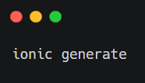
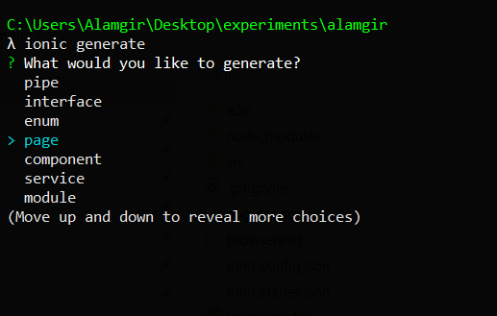
Create new page/component in Ionic
Ionic Pages are just components/modules that show entire view.

Slide 16
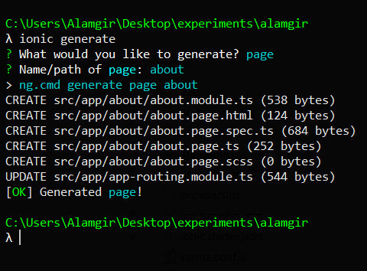
Create new page/component in Ionic
Ionic Pages are just components that show entire view.

